Slide 1
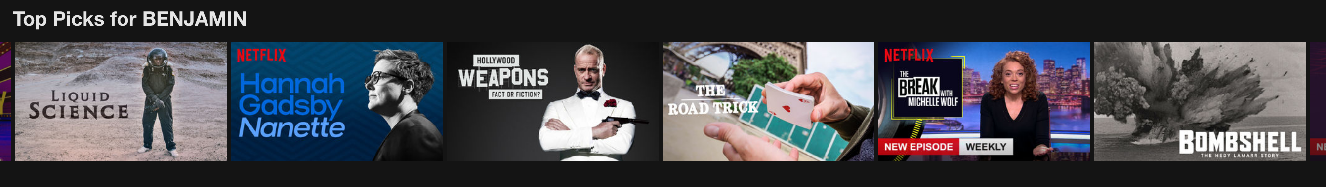
What should we watch tonight?
A Movie Recommender System
Benjamin W. Sturm
June 28, 2018
Notes:
The title of my project is “What should we watch tonight?”: A movie recommender system.

Slide 2
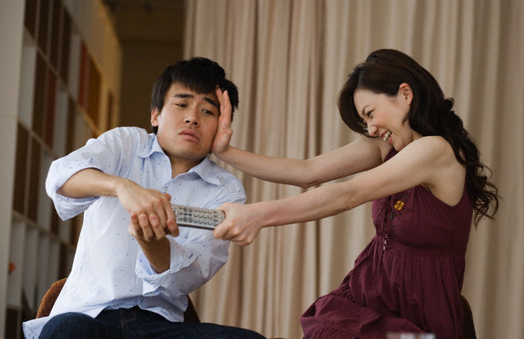
Recommender System Goals
Take control over the movies I watch
Provide top recommended movies and a predicted score
Be able to make recommendations for couples
Notes:
My goal was to build a movie recommender system that would allow me to take control over the movies I watch and not depend on platforms such as Netflix or Amazon to feed me movie recommendations.
I wanted to provide top recommended movies and a predicted score both for individuals as well as for couples.
One of the reasons I wanted to include a movie recommender for couples is that sometimes it can be challenging to come to an agreement over what to watch with your loved ones, so I want to try to prevent scenes like this (-Click-) from happening.

Slide 3
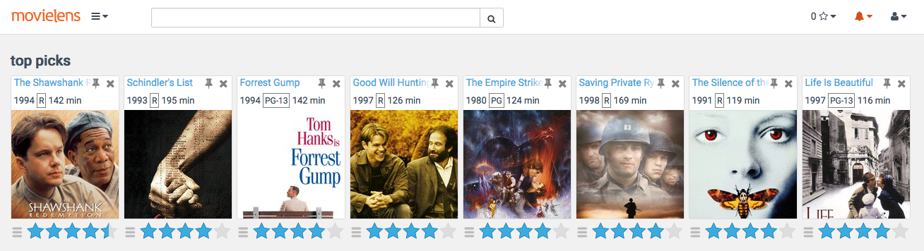
Movie Recommender Data
Employed the MovieLens 20 Million Ratings Dataset
Total number of users: 138,000
Total number of movies: 27,000
Scores range from 0.5 – 5.0
Notes:
For my movie recommender system, I used the MovieLens 20 Million Dataset.
This dataset consists of 20 Million unique ratings from 138,000 users and 27,000 different movies.

Slide 4
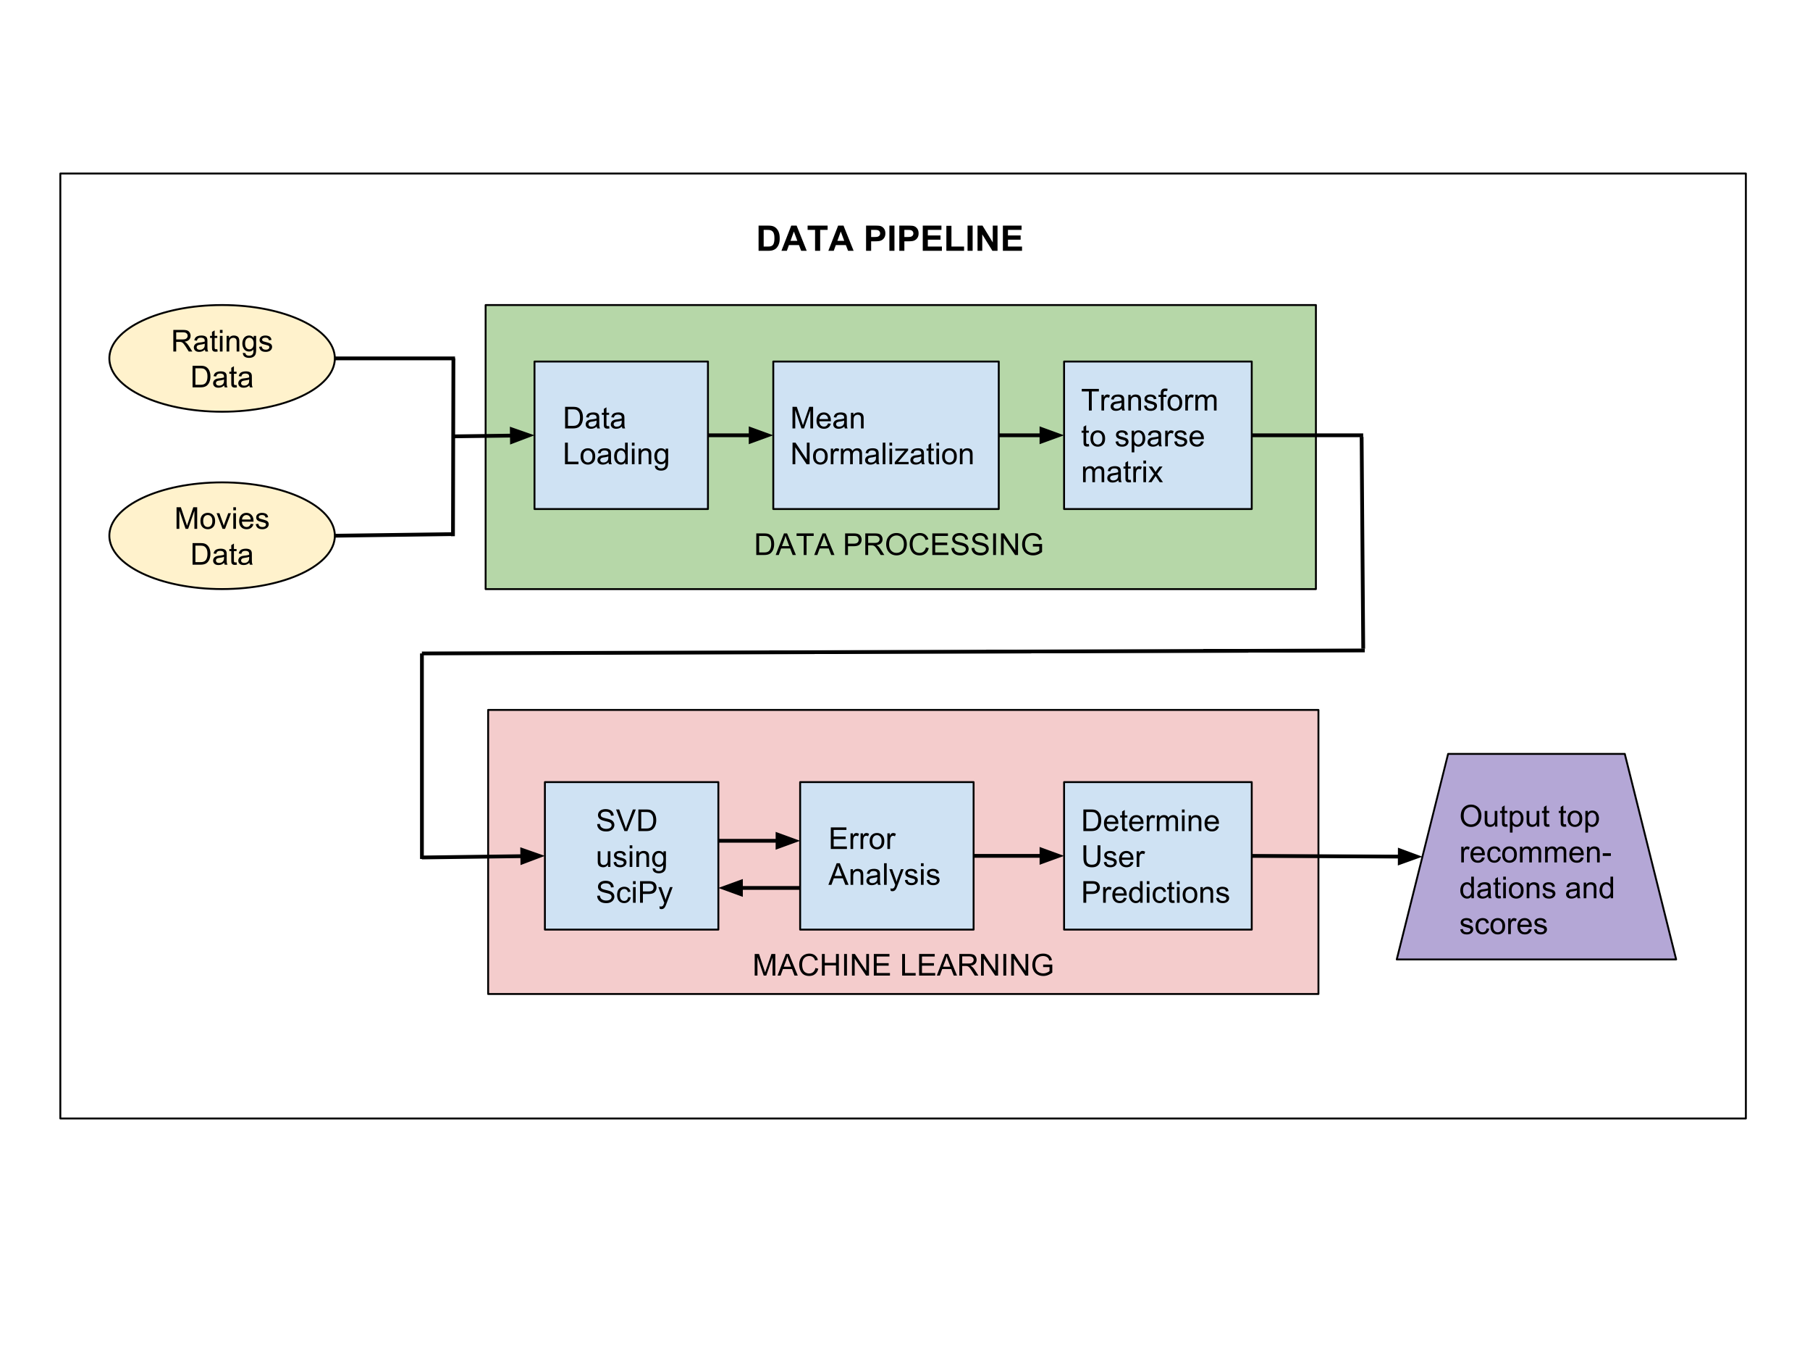
Modeling Approach & Data Pipeline
Implemented a collaborative filtering based recommender
Notes:
I chose to implement a collaborative filtering approach form my movie recommender. Collaborative filtering is a technique to recommend movies to a user based on finding other users with similar tastes.
-Click-

Slide 5
Model Tuning
Tuned my model by adjusting the number of components k
k | Mean Absolute Error | Root Mean Squared Error
100 | 0.744 | 0.958
50 | 0.742 | 0.958
15 | 0.737 | 0.946
P. Cremonesi, R. Turrin, E. Lentini, and M. Matteucci, “An evaluation methodology for recommender systems,” 2008.

Slide 6
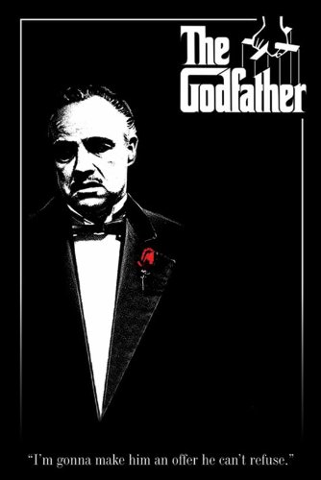

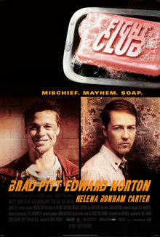
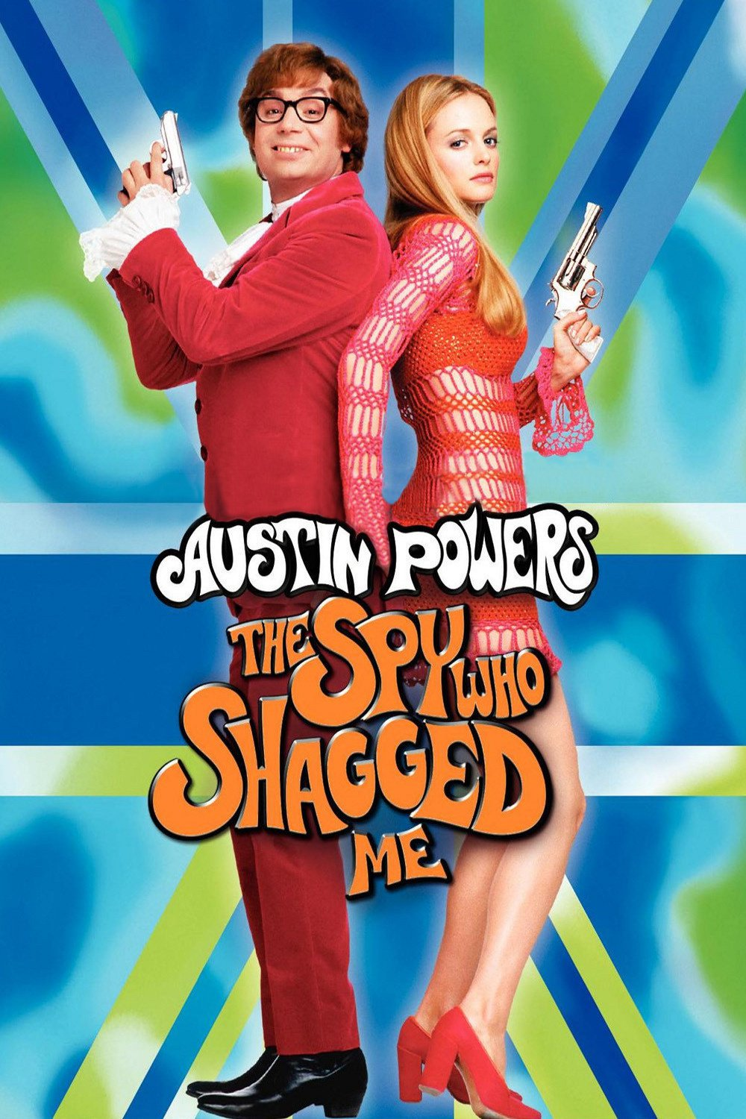
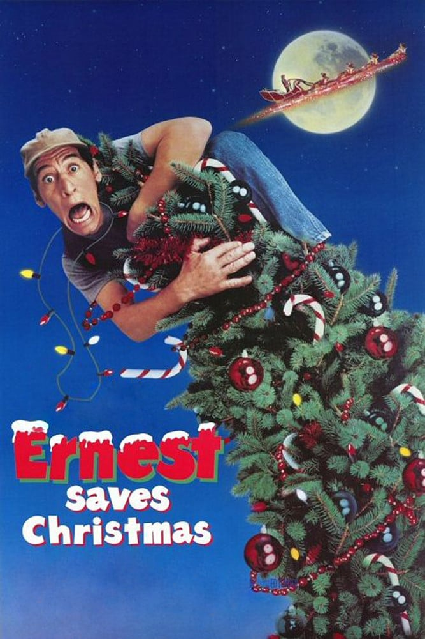
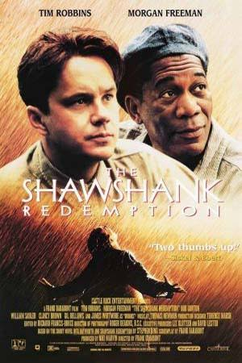

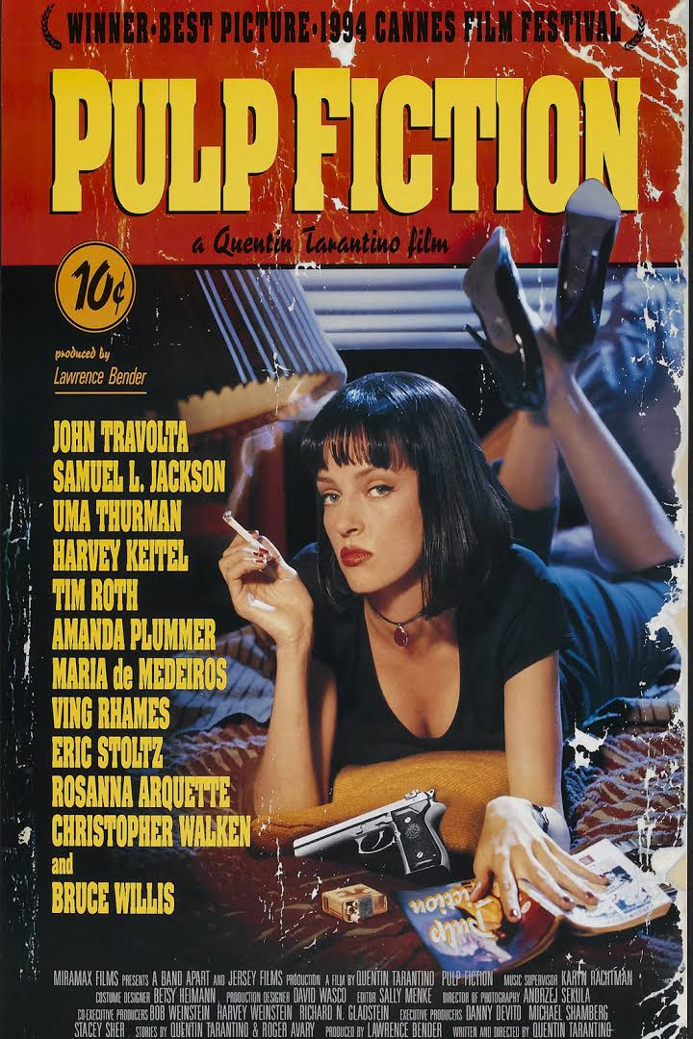
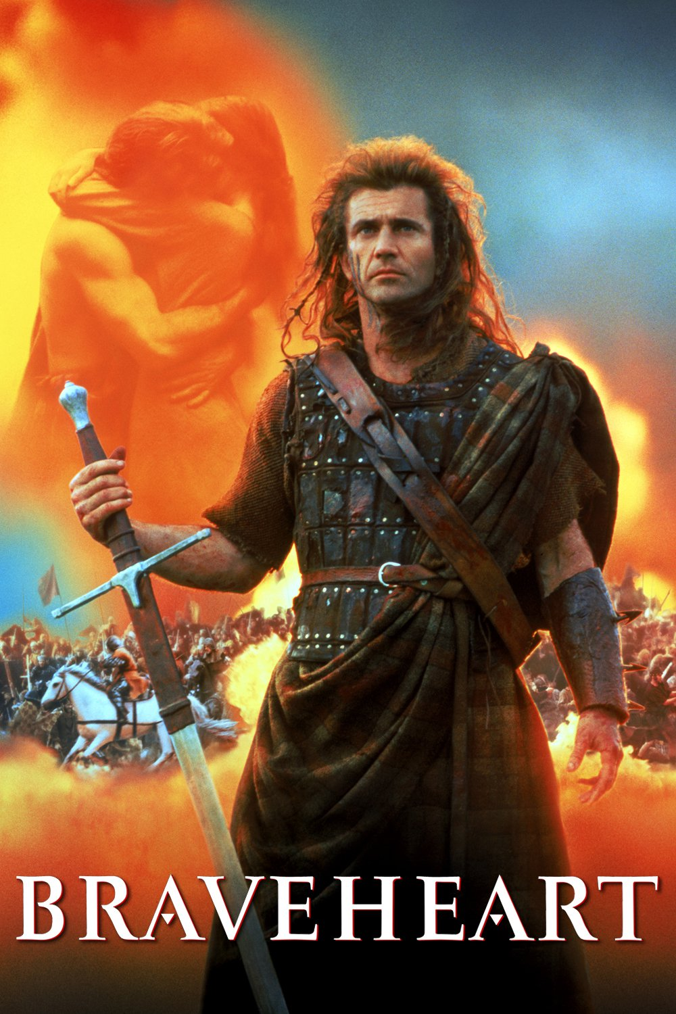
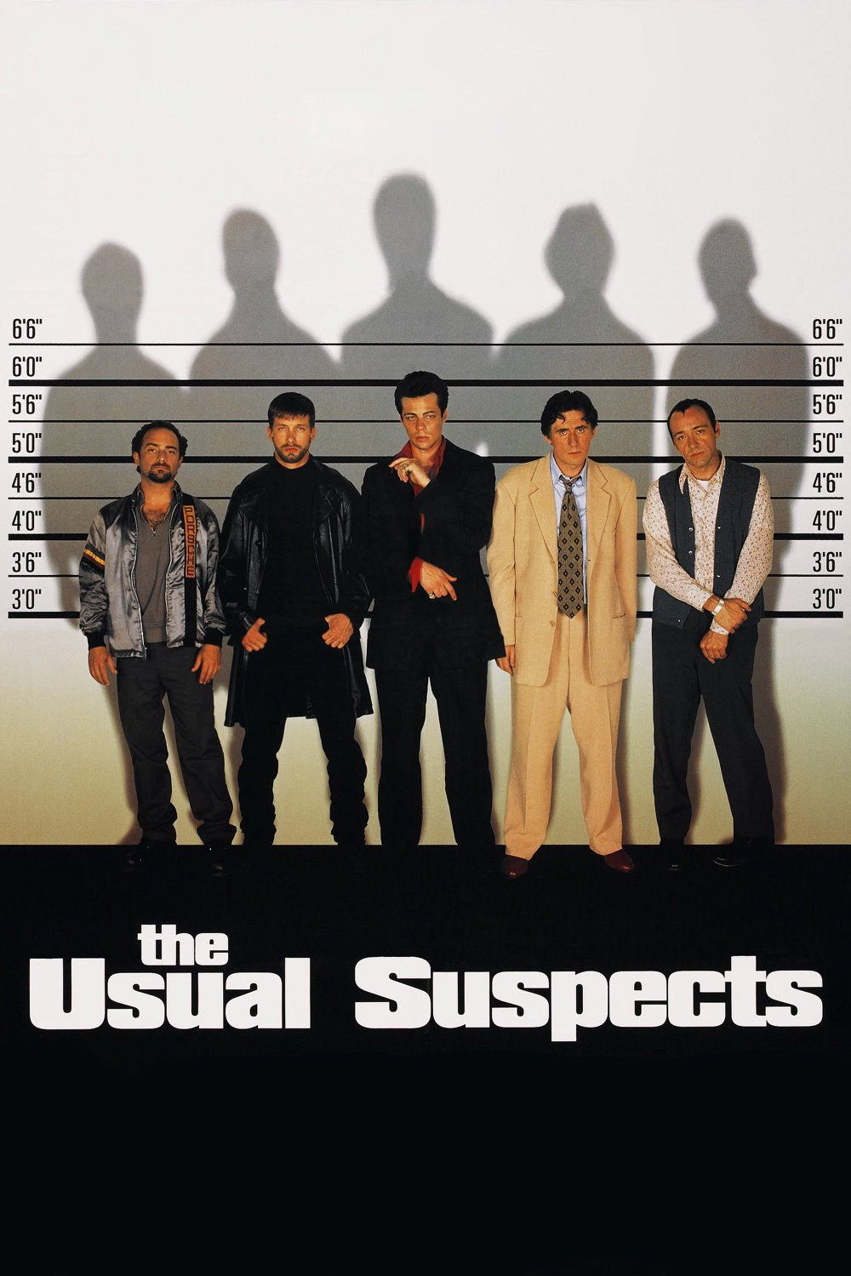
Recommendations for a user that enjoys Thrillers
User Ratings
Movie
Rating | 5.0 | 5.0 | 5.0 | 3.0 | 1.0
Top Recommendations
Movie
PredictedRating | 5.0 | 5.0 | 4.9 | 4.9 | 4.7
Notes:
Now I’d like to discuss some results of my recommender. These results are for a user that enjoys thrillers. This user rated movies such as The Godfather, Hannibal, and Fight Club very high.
-Click-
These are this user’s recommendations and some of the recommendations included Shawshank Redemption, Silence of the Lambs, and Pulp Fiction. So, the recommender appears to be doing a decent job.

Slide 7

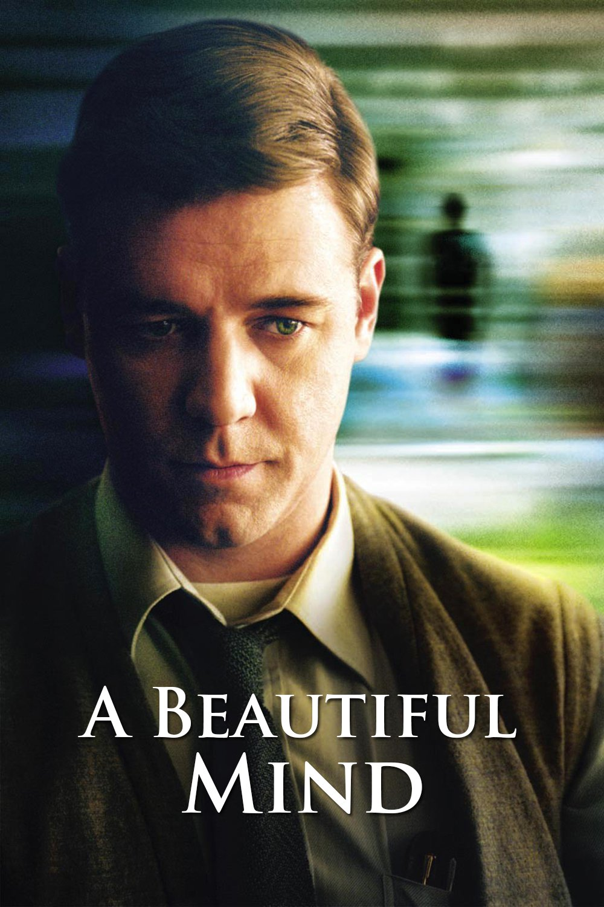
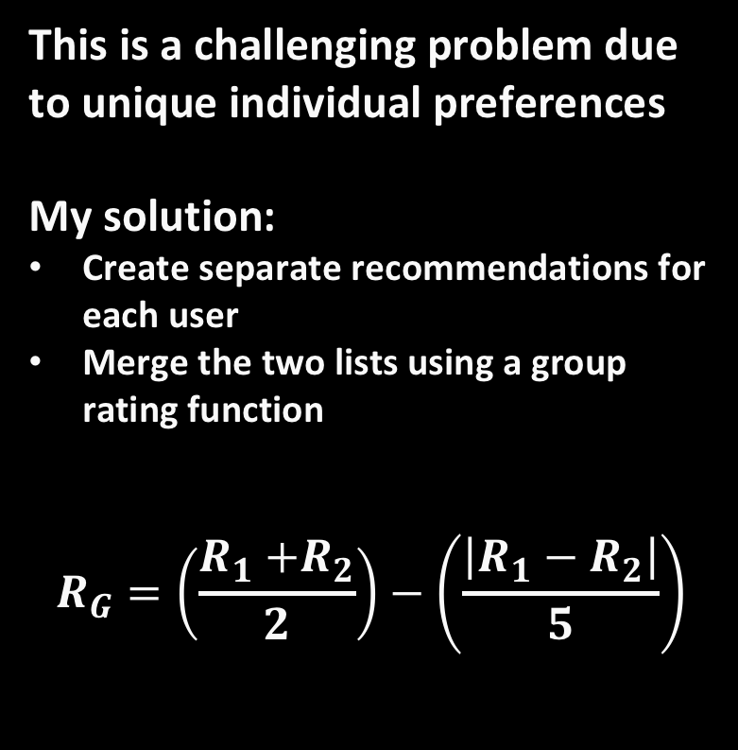
Recommendations for Couples
This is a challenging problem due to unique individual preferences
My solution:
Create separate recommendations for each user
Merge the two lists using a group rating function
$$R_{G}=\left(\frac{R_{1}{+R}_{2}}{2}\right)−\left(\frac{\left|R_{1}−R_{2}\right|}{5}\right)$$
R_{User1}
5.0
4.2
R_{User2}
3.0
3.8
R_{avg}
4.0
4.0
R_{G}
3.6
3.92
Notes:
One of the main goals I wanted to achieve for my project was to build a robust recommender that also works for couples. This is a challenging problem due to the fact that a recommender has to treat the couple as almost a single user with dual personalities.
My solution for this problem was to:
Create separate recommendations for each member of the couple
Merge the two lists using a group rating function. This group rating function calculates the average predicted score minus a penalty term that is proportional to the difference of the two ratings.
-Click-
So for a movie like Pi, User1 and User2 might have dissimilar predicted scores. The average score is 4.0 and the group rating score is 3.6.
For A Beautiful Mind, the predicted scores might be similar. The average score is still 4.0, but the group rating is now 3.92, since the difference is small.

Slide 8

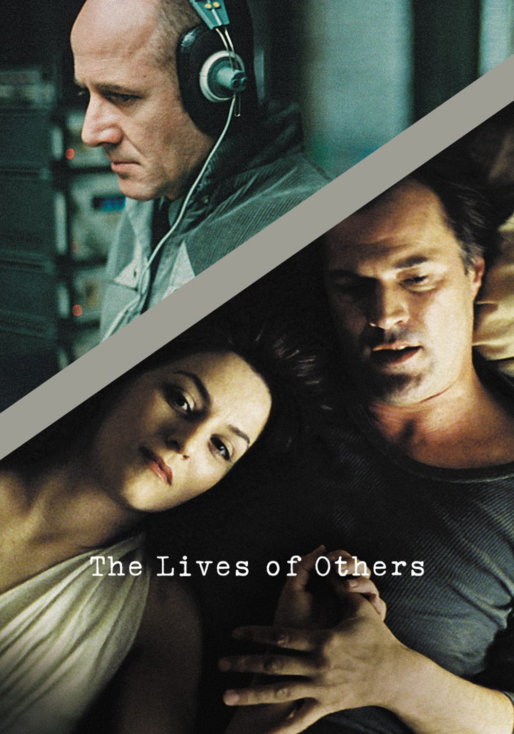


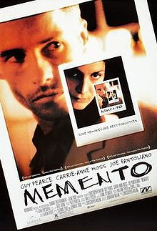
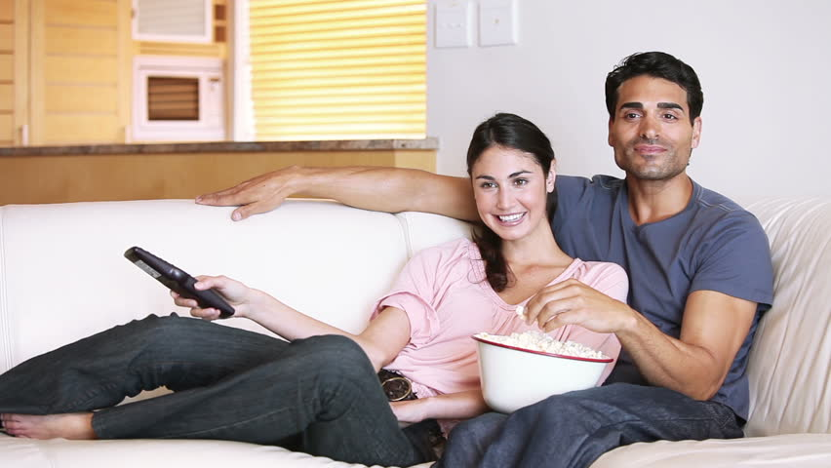
Recommendations for my better half and I
Top Picks or Us
Movie
Rating | 4.5 | 4.3 | 4.3 | 4.5 | 4.3 | 4.3
Notes:
I tested my couples movie recommender algorithm on my better half and I and the results helped to provide confirmation of my model. Namely, many of the movies recommended were ones we have already seen and also really liked. –Click- There were definitely some new ones in there, so I’m excited to check those out as well. -Click-
My hope is that my recommender will help to avoid confrontation and lead to happy movie watching for years to come.

Slide 9
Outlook for Future Work
Do topic modeling on movie tags dataset
Incorporate topic data into a hybrid model
Build a web app
Notes:
There are many ways that I would like to extend this work in the future.
For starters, I would make use of another dataset that has user specified tags for each movie and do some topic modeling on these tags.
With these topics, I could then incorporate some content-based features in order to build a hybrid model.
Lastly, I would like to build a web application (likely with Flask) to allow anybody who is interested to upload their own unique ratings and see their list of recommended movies.
-OR-
There are many ways that I would like to extend this work in the future. For sake of time, I’ll conclude my talk here, but I would be happy to discuss my ideas with you in person.

Slide 10

Thank you!
Benjamin W. Sturm
- Ph.D. in Nuclear Engineering
email: bwsturm@gmail.com
LinkedIn: bwsturm
Github: bwsturm

